Slide 1



Department of Computer Science and Engineering
Tamil Nadu General Provident Fund Mobile Application for Accountant General Of Tamil Nadu
Team Members Name / Register Number
LOKESHWARAN M S / 211420104150
Guide Name & Designation
Coordinator Name & Designation
Mr. M. MAHENDRAN M.Tech.,
ASSOCIATE PROFESSOR
Dr. G. SENTHILKUMAR M.E., PhD.,
PROFESSOR

Slide 2
Introduction
The primary goal of the Tamil Nadu General Provident Fund Mobile Application is to enhance the efficiency of PF account management for the Accountant General of Tamil Nadu.
By offering real-time balance checks, detailed account summaries, and transaction histories, the application empowers users to make informed financial decisions.
The TNGPF (Tamil Nadu Government Provident Fund) App represents a significant leap forward in PF account management for employees of the Tamil Nadu Government.
This innovative mobile application provides users with a secure and user-friendly interface to access their PF accounts conveniently from their smartphones.
By leveraging advanced encryption techniques and robust security measures, the app ensures the confidentiality and integrity of user data.

Slide 3
Objective of the Project
Accessibility: Provide easy access to PF account details, including current balance, account slips, and transaction history, enabling employees to stay informed about their financial status.
Efficiency: Streamline PF account management processes, reduce paperwork, and administrative burden by digitizing manual tasks such as account slip retrieval and balance checking.
Security: Implement robust security measures to safeguard user data and ensure the confidentiality and integrity of sensitive information, such as login credentials and financial transactions.
Transparency: Enhance transparency and accountability in PF account management by providing employees with accurate and up-to-date information about their contributions, withdrawals, and balances.
User Experience: Improve the overall user experience by designing an intuitive interface and intuitive navigation, making it easy for users to access and navigate through the app's features.
Compliance: Ensure compliance with regulatory requirements and standards governing PF account management, including data privacy regulations and security protocols, to maintain trust and confidence in the platform.

Slide 4
Literature Survey
User-Centric Mobile App Design: Designing intuitive and user-friendly mobile interfaces is crucial for public sector apps, emphasizing the importance of understanding user needs and preferences.
Security and Privacy Concerns in Mobile Apps: Ensuring the confidentiality and integrity of sensitive data is paramount, necessitating robust security measures and authentication mechanisms.
Integration of Backend Systems with Mobile Apps: Seamless integration with backend systems, achieved through APIs and web services, facilitates real-time data access and accuracy.
Mobile App Performance Optimization: Techniques such as code optimization and caching strategies enhance app responsiveness and reduce load times for an improved user experience.
Usability and Accessibility in Mobile App Design: Designing mobile apps that are accessible to users with disabilities and meet usability standards ensures inclusivity and user satisfaction.

Slide 5
Existing System
The existing model is a website ‘https://www.agae.tn.nic.in/onlinegpf/’ accessed by Tamil Nadu Government employees to manage their Provident Fund(PF) accounts and maintained by TNAGAE .
Users are required to log in again each time they visit the website.
When account slips are downloaded, they are in PDF format and readable on desktop and laptop computers.
However, on mobile devices, account slips are downloaded as HTML files due to the use of an older version of ASP.NET.
This results in PDF files that are unreadable and unrecoverable on mobile devices, posing a usability issue for users accessing their Provident Fund(PF) accounts on mobile platforms.

Slide 6
Proposed System
The proposed model involves the development of a mobile app for Tamil Nadu Geovernment employees to access their Provident Fund(PF) accounts conveniently.
Upon initial login, users are prompted to set a PIN for subsequent logins. The app retains the user's login state until they choose to logout, making it more user-friendly and reducing the need for repeated logins.
To address the issue of unreadable PDFs on mobile devices, the mobile app uses Python Flask to process byte data received from the API.
The app generates PDF files from the byte data and serves them through the Flask API, ensuring that account slips are downloaded in the correct format and are readable on both desktop and mobile platforms.

Slide 7
Software / Hardware used
SOFTWARES :
Component | Technology Used
Web Server | MS Windows Server 2008 Enterprise Flask Server
RDBMS | PostgreSQL 9.2
Front-end | Dart
Back-End | Rest API and Python
Frame-Work | Flutter
Target Platform | Android, IOS
IDE | Android Studio and VS Code
HARDWARES :
Component | Technology
Device | PC
Processor | Pentium IV
MEMORY | 2GB

Slide 8
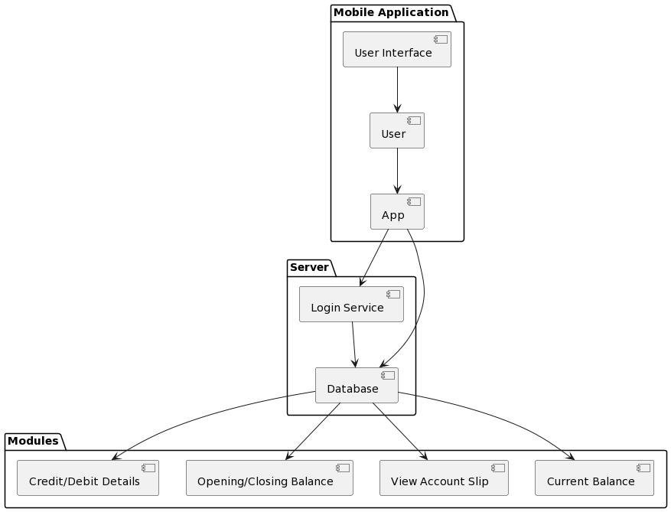
Architecture / Methodology used

Slide 9
System Implementation
Requirements Analysis:
Gather user requirements and regulatory constraints.
Define functional and non-functional requirements.
Design Phase:
Architect system components and data flow.
Design user interface wireframes for intuitive navigation.
Development:
Develop mobile app frontend using Flutter framework.
Implement backend services with Python Flask for data retrieval and processing.
Integrate authentication using OAuth 2.0 for security.
Testing:
Conduct rigorous testing, including unit, integration, and user acceptance testing.
Validate security measures and user experience.
Deployment:
Deploy app to Google Play Store and Apple App Store.
Deploy backend services on cloud infrastructure for scalability.
Maintenance and Support:
Provide ongoing maintenance for bug fixes and updates.
Offer user support through helpdesk and documentation.

Slide 10
Result & Discussion
Improved Accessibility: TNGPF App facilitated easy access to Provident Fund account details for Tamil Nadu Government employees.
Enhanced Efficiency: Streamlined processes led to quicker retrieval of PF information and reduced administrative burden.
Transparent Transactions: Increased transparency in fund management fostered trust among users and administrators.
Positive User Feedback: High user satisfaction ratings reflected the app's user-friendly interface and functionality.
The TNGPF App has successfully addressed the need for a modernized and user-friendly platform for Provident Fund management.
User feedback has been instrumental in shaping app features and functionality, emphasizing the importance of user-centric design.
Ongoing support and updates will ensure the app remains relevant and effective in meeting user needs and regulatory requirements.

Slide 11
Reference Paper/ URL
TNGPF Website - https://www.agae.tn.nic.in/onlinegpf/
GPF Online Uttarakhand Mobile Application
Smith, J., & Jones, A. (Year). "Digital Transformation in Government Services: A Review of Current Trends and Future Directions". Government Information Technology Journal, 20(3), 123-145.
Brown, C., & Miller, R. (Year). "User-Centric Mobile App Design: Principles and Best Practices". Mobile User Experience Journal, 15(2), 67-82.
Patel, S., & Gupta, R. (Year). "Security and Privacy Concerns in Mobile Apps: Strategies for Mitigation". Mobile Security Journal, 10(4), 189-205.
Lee, H., & Kim, S. (Year). "Integration of Backend Systems with Mobile Apps: Best Practices and Implementation Strategies". Mobile Computing Conference Proceedings, 25-38.
Wang, L., & Zhang, Q. (Year). "Mobile App Performance Optimization: Techniques and Tools". Mobile Computing Journal, 30(1), 45-60.
Garcia, M., & Rodriguez, E. (Year). "Usability and Accessibility in Mobile App Design: Guidelines and Recommendations". Mobile User Interface Journal, 12(3), 105-120.

Slide 12
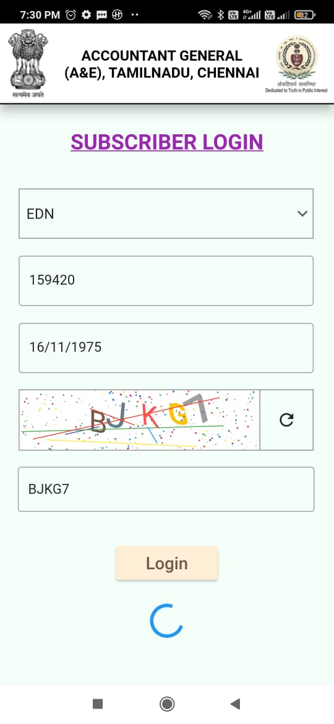
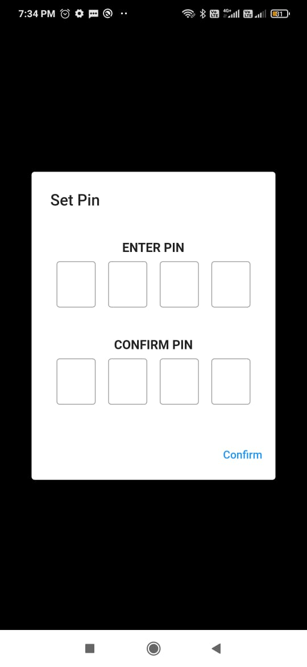
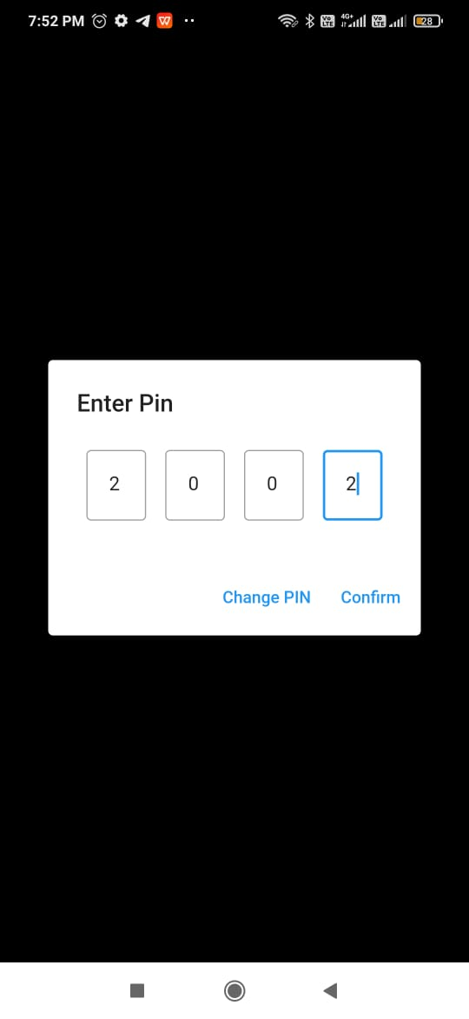
Screen Shots

Slide 13
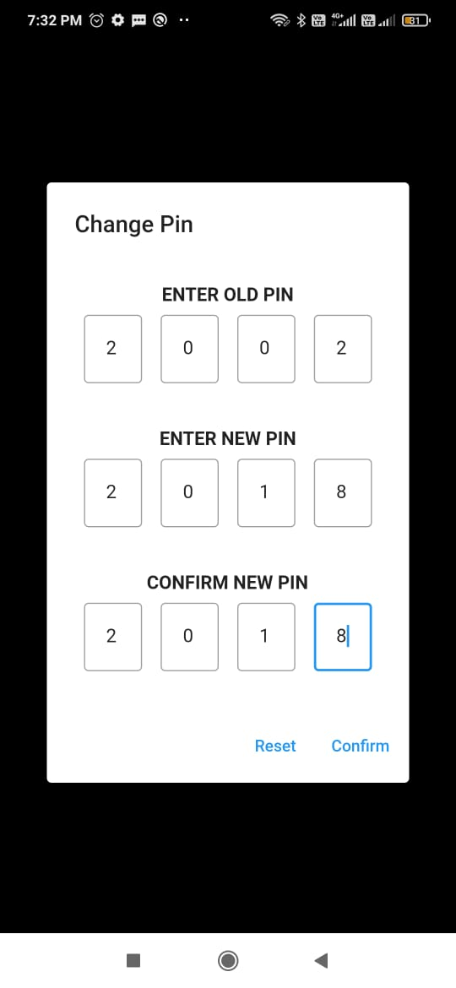
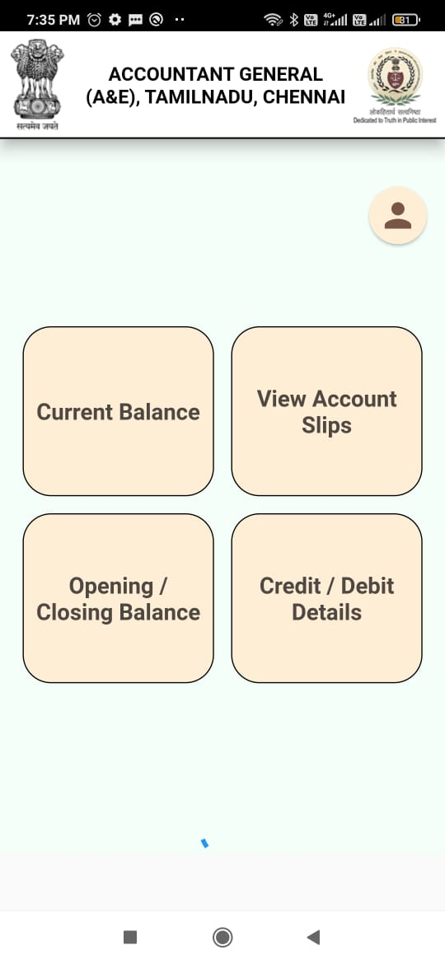
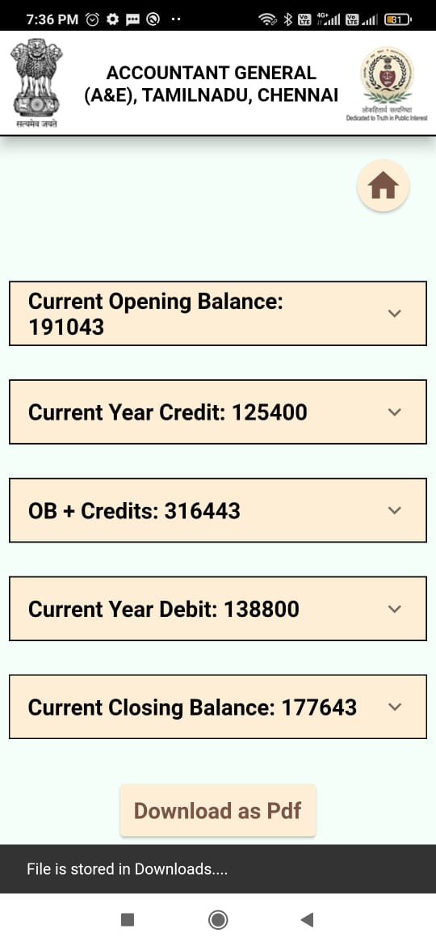

Slide 14
